Slide 1
\LaTeX
For Scientific Documentation
By Ammar Taha Mohamedy
Index Preparation

Slide 2
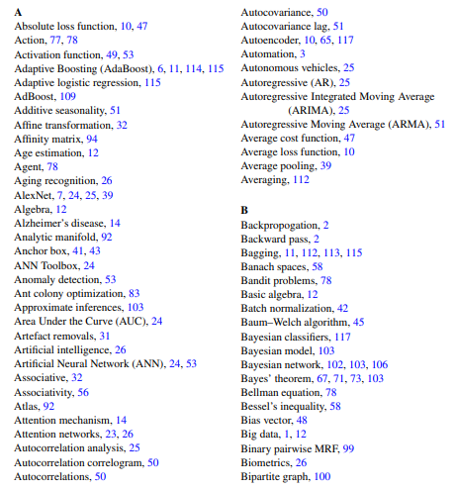
The Need for Indexes
\usepackage{imakeidx}
\makeindex[]
\index{Action}
…
\index{Algebra}
\ printindex

Slide 3
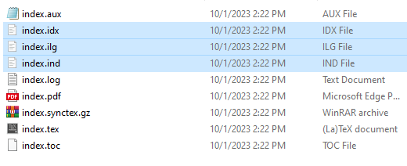
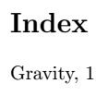
Index Generation Process
tex
pdflatex Engine
.ist
.idx
\index{Gravity}
pdflatex
\indexentry{Gravity}
{1}
MakeIndex
Input .tex
.idx File
.ilg
MakeIndex
.ind
\begin{theindex}
\item Gravity, 1
\end{theindex}
tex
pdflatex
pdflatex Engine
.ind File
Output File
Typeset Output

Slide 4
Thanks for Watching !!

